Slide 1
Sentiment Analysis of Movie Reviews Using Machine Learning Techniques
Alaa Ayach Aditya Kundu

Slide 2


The Problem
Automated sentiment analysis
A profound Research area
What machine learning techniques?
How challenging is the task of extracting sentiment?

Slide 3
The Problem
Sentiment is hard to classify:
Language
Grammar
Coloquial words
Sarcasm
Emoticons
Abbriviations
Short hand

Slide 4
Approaches
Naïve Bayes
Support Vector Machines
Random Forests
Feature selection: Unigrams, Bigrams and trigrams
Logistic regression on extracted features.

Slide 5
Implementation Details
Text Processing
Categorizing words
Sentence scoring
Cross Validation
Modeling and Evaluation
Document term matrices for n-grams

Slide 6
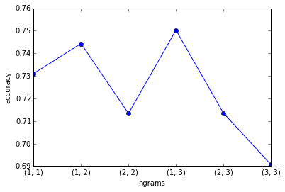
Results and Discussion
Best Accuracy with uni-trigrams: 75.33%
Worst Accuracy with tri-trigrams: 69.25%
Still better than traditional.
Average: 73.561
N-Gram with Logistic model

Slide 7
Results and Discussion
Poor performance of traditional approaches
Better with n-grams
Computationaly expensive
Sentiment analysis is challenging task
METHOD | ACCURACY (%)
Naïve Bayes | 61.996
Support Vector Machine | 59.308
Random Forests | 61.781
One-three n grams with logistic regression | 75.333
Average on n-grams | 73.561

Slide 8
Thank You!
Questions?

